Slide 1
Regular Expressions with a bit of Automata Theory
Prof. Darrell Long
CSE 13S

Slide 2

Understanding Regular Expressions requires a little Automata Theory
$A=\left\langle Σ,S,s_{0},δ,F\right\rangle$
$Σ$ is the alphabet
$S$ is the set of states
$s_{0}$ is the unique start state
$δ$ is the state transition function
$F$ is the set of final states

Slide 3
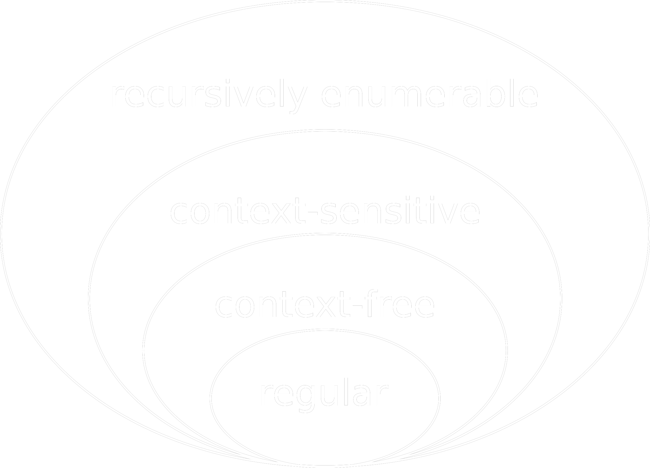
Types of Automata
Deterministic Finite Automata (DFA)
Also called Finite State Automata
Single transition per letter
Recognize Type 3 grammars
Recognize regular expressions
Non-Deterministic Finite Automata (NFA)
Have many transitions per letter
Have transitions for the empty string
Equal in power to DFA
Push Down Automata
We have a stack
Recognize Type 2 grammars
Recognize context-free languages
Linear bounded Turing Machine
We have a linearly bounded tape
Recognize Type 1 grammars
Recognize context-sensitive languages
Turing Machine
We have an infinite tape
Recognize Type 0 grammars
Can compute any computable function

Slide 4
How do they work?
Begin at the start state
For each letter, apply the state transition function to find the next state
When we get to the end of the string if we are in a final state then we accept

Slide 5


Letters and strings
$a∈ Σ$, we call $a$ a letter
$x∈Σ^{∗}$, we call $x$ a string
$λ∈Σ^{0}$ is the empty string
$λ$ is a string
If $x$ is a string then $a⋅x$ is a string
$Σ^{∗}= \bigcup_{i=0}^{∞}{Σ^{i }}$

Slide 6



$δ$ and $\overline{δ}$ functions
$δ:S ×Σ⟼S$
$\overline{δ}:S×Σ⟼S$

Slide 7
DFA examples

Slide 8
NFA examples

Slide 9


$λ \left(ε\right)$ transitions
$λ \left(ε\right)$-closure

Slide 10
Thompson’s Construction

Slide 11
Formal Regular Expressions

Slide 12
Simulating NFA
Instead of tracking one state, we must track all active states

Slide 13
NFA can be converted to equivalent DFA
But may be exponentially larger

Slide 14
UNIX Regular Expressions

Slide 15
Globbing
This is not the same as a regular expression
Some people calling a “wild card” or “wild carding”

